Slide 1
Speed Typing Test
Done by:-
Chaitanya 1911005
Mayank 1911006
Ishit 1911010

Slide 2
Problem Definition
Typing speed test is a desktop based GUI application where user can test their typing speed and improve their speed.
We have created a typing game that presents a simple typing challenge , where user can the performance of his typing speed by Words Per Minute (WPM) and the accuracy of the typed characters.
This project is useful and helpful for those people who are not good at typing, they can practice their speed and become good at it.

Slide 3
Scope
Smooth UI/UX for users.
Displaying time that the user has taken to complete the test.
Displaying accuracy and word per minute (wpm) so that user can see the performance of his speed
Users can re apply for the test by clicking the reset button.

Slide 4
Functionalities
The draw_text() technique for Game class is a helper function work that will draw the content on the screen.
The get_sentence() technique will open up the file and return an irregular sentence from the rundown. We split the entire string with a newline character.
The show_results() technique is where we calculate the speed of the user’s typing. The time begins when the user clicks on the input box and when the user hits the return key "Enter" at that point we play out the distinction and calculate time in seconds.
The run() method-This is the primary strategy for our group that will deal with all the events/occasions. We call the reset_game() strategy at the beginning of this technique which resets all the variables.
The reset_game() method resets all variables so we can begin testing our typing speed again.

Slide 5
Component Diagram

Slide 6
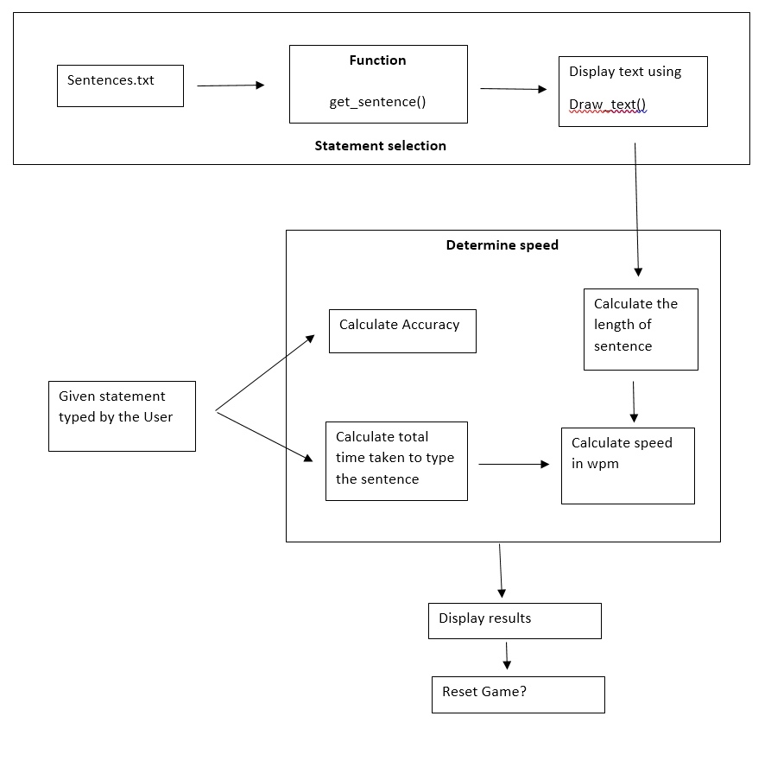

Slide 7
API/Package
Following are the API and package used in this project:
Pygame: pygame is a free and open-source cross-platform library for the development of multimedia applications like video games using Python.
Time: The Python time module provides many ways of representing time in code, such as objects, numbers, and strings. It also provides functionality other than representing time, like waiting during code execution and measuring the efficiency of your code.
Random: The random module is a built-in module to generate the pseudo-random variables. It can be used perform some action randomly such as to get a random number, selecting a random elements from a list, shuffle elements randomly, etc.

Slide 8
Difficulties faced:
We tried to implement GUI using tkinter but the code was considerably sizeable which could be avoided using pygame so we used pygame for GUI.
As we all were new to pygame we faced all of the difficulties for layouting the components of GUI,placing them in the proper place.

Slide 9
Contribution Table
Activity | Performed by | Role
GUI design | Ishit and Chaitanya | Analysing the layout of the project.
GUI coding | Chaitanya | Implementing the GUI components
Functions Implemented | Mayank and Ishit | Taking input and calculating speed, accuracy, time, etc
Testing and error fixing | Chaitanya and Mayank | Fixing all the errors.
Presentation and report | Mayank and Ishit

Slide 10
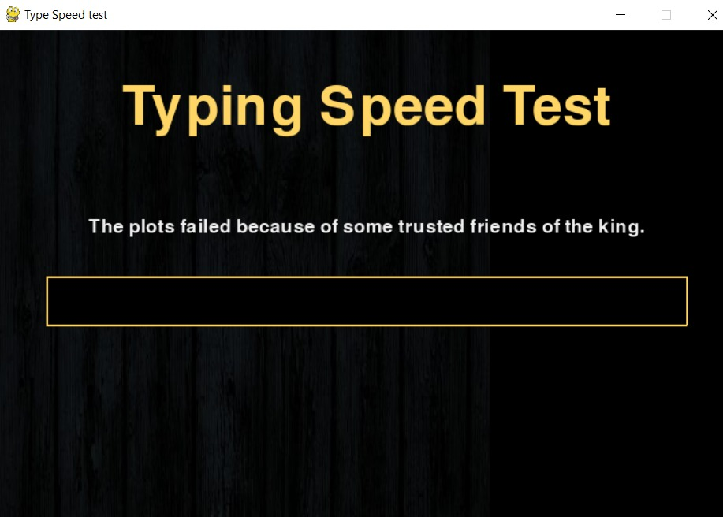
Demo

Slide 11
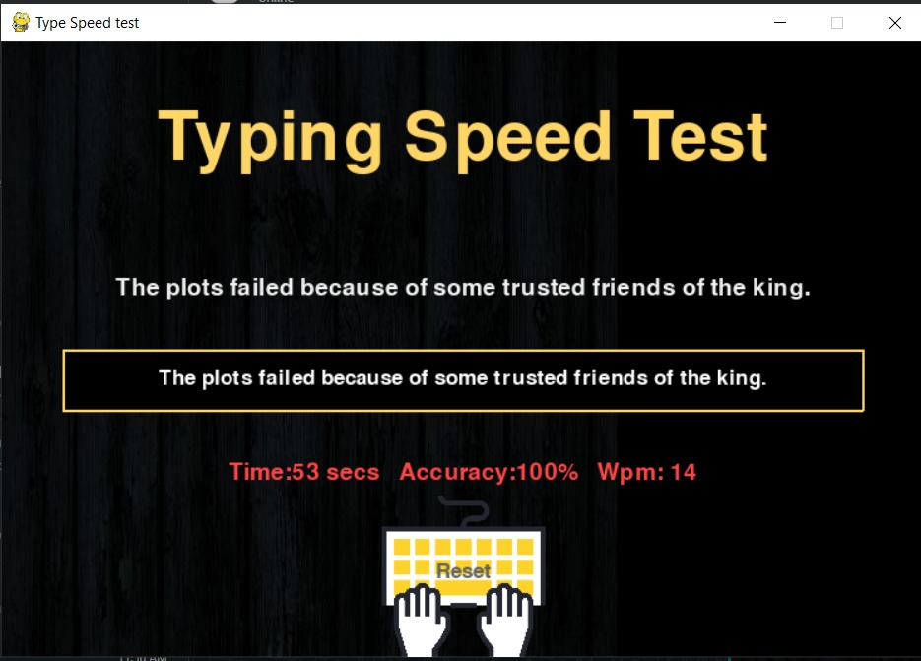
Demo

Slide 12
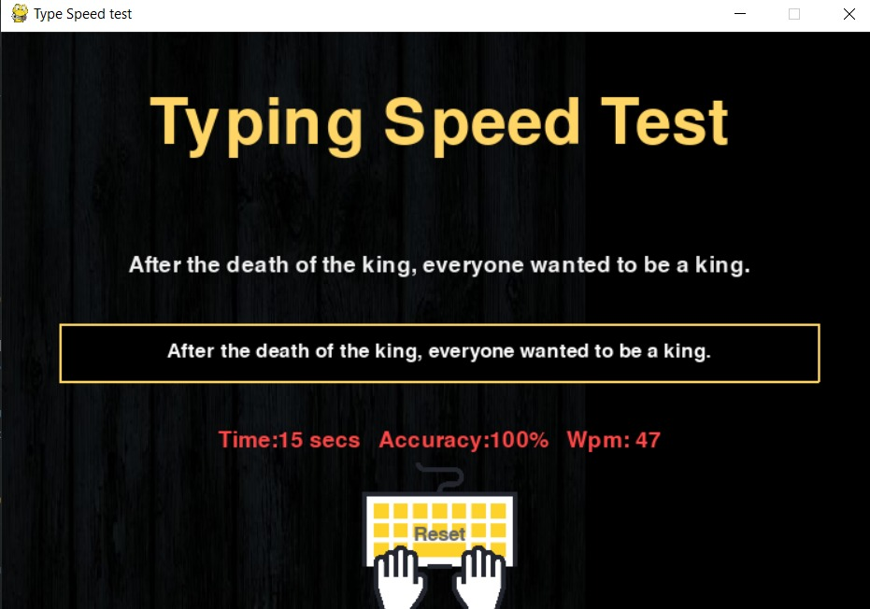
Demo

Slide 13
Github Link
https://github.com/Mayank7832/Typing-Speed-Test.git

